Slide 1

Pharmacy Tools and Resources
Notes:
Hello! My name is Amanda Fairbanks and I am the Account Manager at HealthPartners that works with Sourcewell. I am here today to talk about some of the different pharmacy tools and resources available to you. So lets get started!

Slide 2
Prescription coverage
Check your formulary to understand your costs and get support if your medicine isn’t working for you.
Covered
Might be covered but costs more
Not covered
healthpartners.com/preferredrx
Notes:
One of the most important pieces of pharmacy is knowing what you’ll pay for your medicine. HealthPartners has several tools and resources to help you understand your costs and get support if your medicine isn’t working for you.
The first way is by Checking your formulary
A formulary, also called a drug list, tells you what medicines are covered by your health plan and generally how much you’ll pay. You’ll also learn if there are any requirements before you can start a medicine.
Your formulary is called PreferredRx.
Go to healthpartners.com/preferredrx.
Search by the name or type of medicine.
Use your Summary of Benefits and Coverage (SBC) in your enrollment materials to understand how each type of medicine is covered.

Slide 3
Save money on your medicines
Try generics
Search for
the lowest cost
Talk to your doctor or pharmacist
healthpartners.com/pharmacy
Talk with a pharmacy navigator
Meet with
a pharmacist
Call Member Services
healthpartners.com/mtminfo
Notes:
Try generics
Generics are just as safe and effective as brand-name medicines, but they cost a lot less. Save money by talking to your doctor or pharmacist about switching to a generic medicine.
Talk with a pharmacy navigator
One call will give you answers to your questions around benefits, coverage, costs, formularies and more. Call Member Services at the number on the back of your member ID card. Ask to talk with a pharmacy navigator.
Meet with a pharmacist
In a one-on-one visit, a pharmacist will review your medicines with you to make sure they’re working and are right for you. Plus, it’s free. Visit healthpartners.com/mtminfo to learn more.

Slide 4
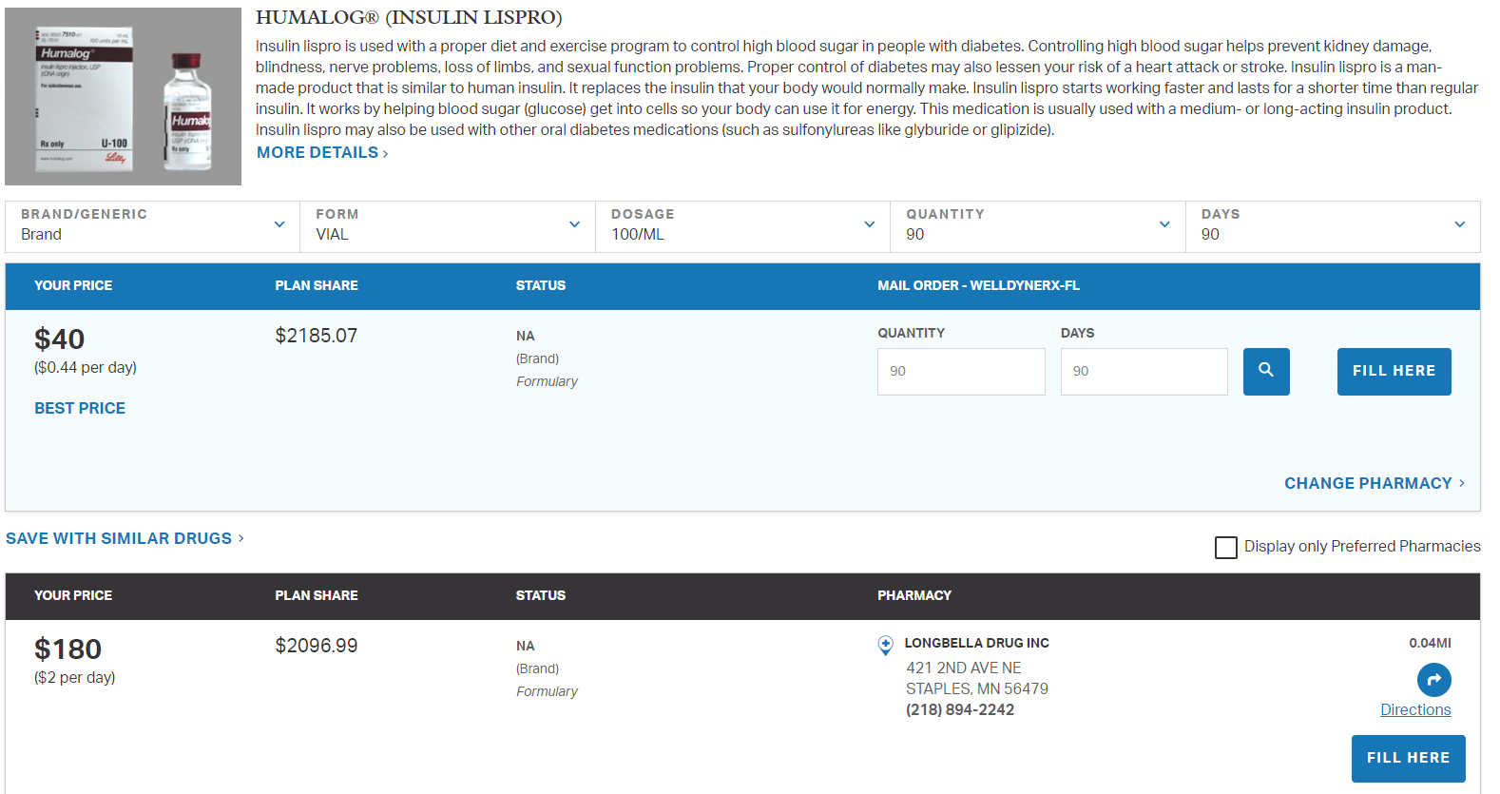
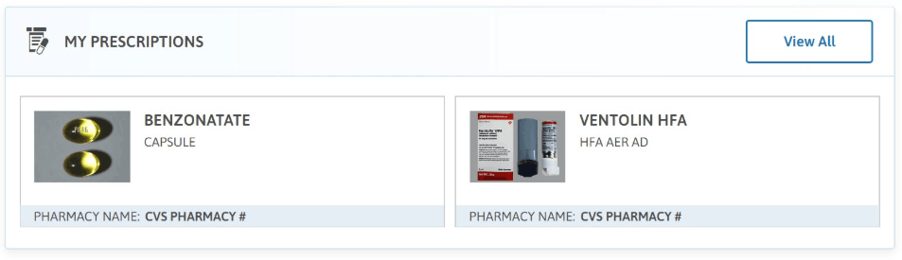
Pharmacy shopping tool
Find lowest cost pharmacy
View prescription history
See missed savings
Read detailed medicine descriptions
& more!
Notes:
Search for the lowest cost
Shopping for the lowest price medicine is easier than comparing prices for airline travel. You can use the Prescription shopping tool to:
Find the lowest cost for your medicine
Compare current prices at pharmacies near you
Understand what medicines are covered by your health plan
Transfer prescriptions to the lowest cost pharmacy
Know if you have available refills
See if you have a prior authorization and when it expires
Download tax reports of what you spent last year
Members can get started at healthpartners.com/pharmacy.

Slide 5
Medicine delivered to your door
Skip the trip to the pharmacy. Get your prescriptions mailed to your home.
Five great things about mail order
You’ll never pay for standard shipping.
Refilling your medicine online or with our mobile app is easy.
All orders are sent in a tamper resistant, plain package to make it more private.
Safety is important to us. You’ll get the best quality medicine.
You'll get your medicine delivered within seven to ten days.
Getting your medicine through mail order often costs less than retail pharmacies.
healthpartners.com/mailorder
Notes:
As I mentioned in the previous slide, you can fill your medications through our mailorder pharmacy, WellDyneRx.
5 great things about mail order
You’ll never pay for standard shipping.
Refilling your medicine online or with our mobile app is easy.
All orders are sent in a tamper resistant, plain package to make it more private.
Safety is important. You’ll get the best quality medicine.
You'll get your medicine delivered within seven to ten days.
To get started visit healthpartners.com/mailorder

Slide 6
Thanks!
healthpartners.com

